Slide 1
REPORT ON VULNERABILITY
NETSPARKER
INTERNSHIPSTUDIO.COM

Slide 2
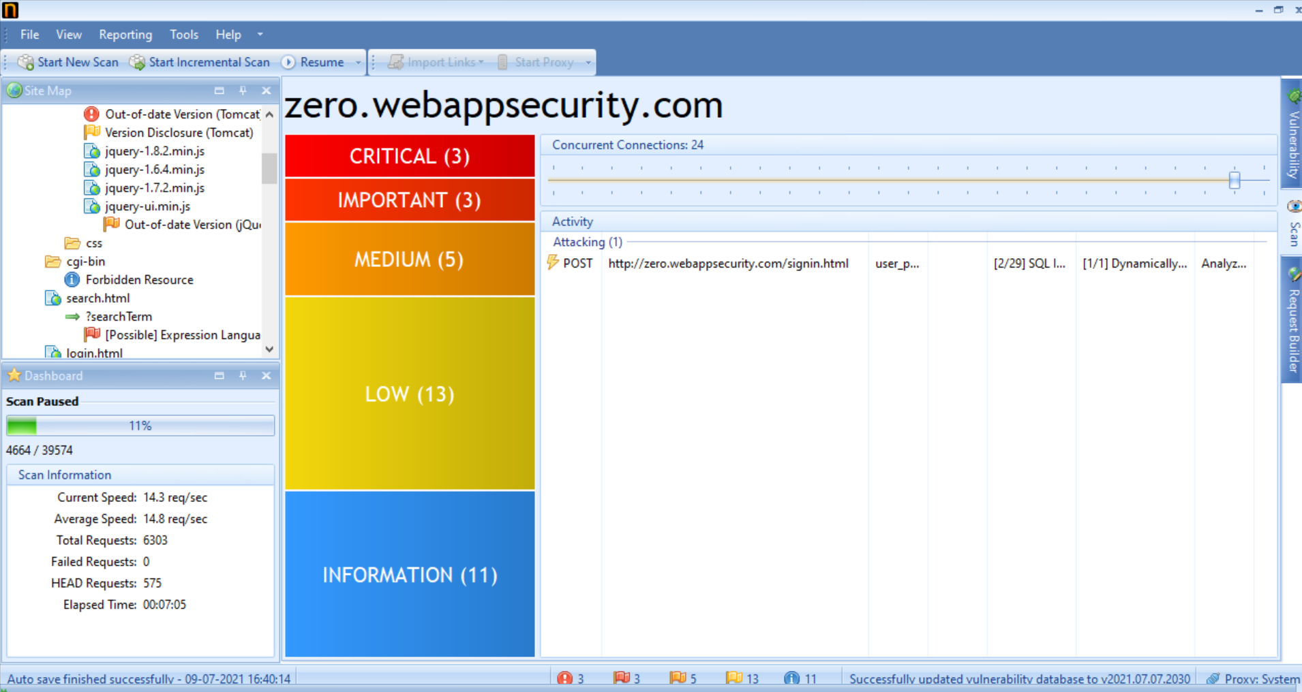
VULNERABILITY SCAN ON : http://zero.webappsecurity.com/ (contains 4 critical and 66 other vulnerabilities)

Slide 3
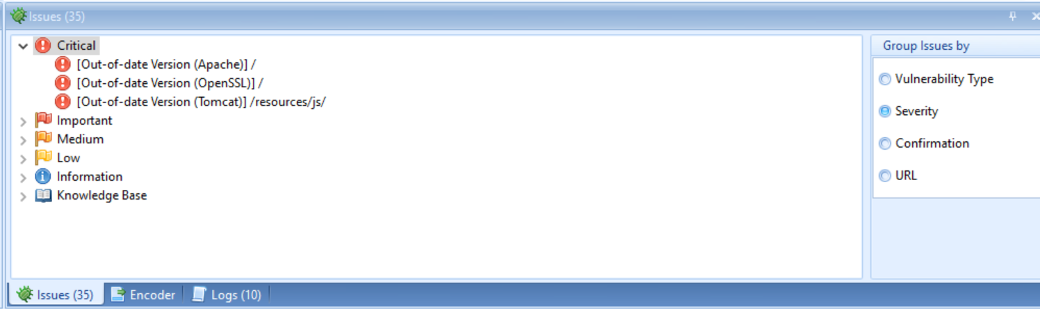
CRITICAL VULNERABILITIES

Slide 4
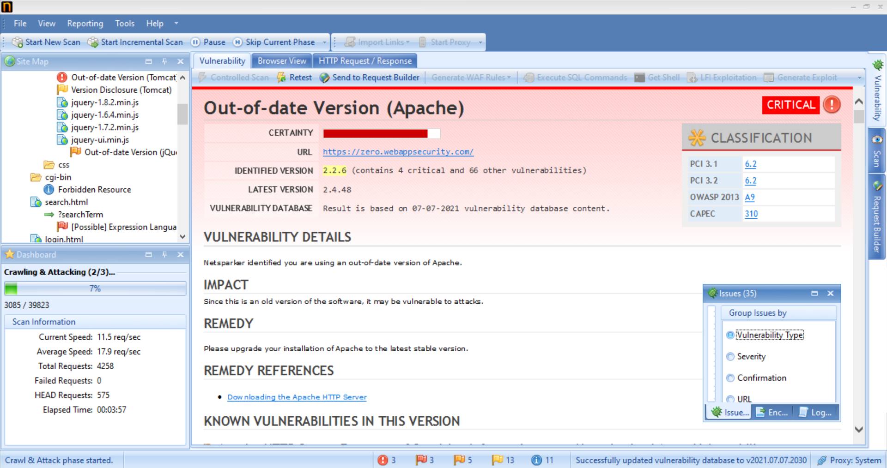

Slide 5
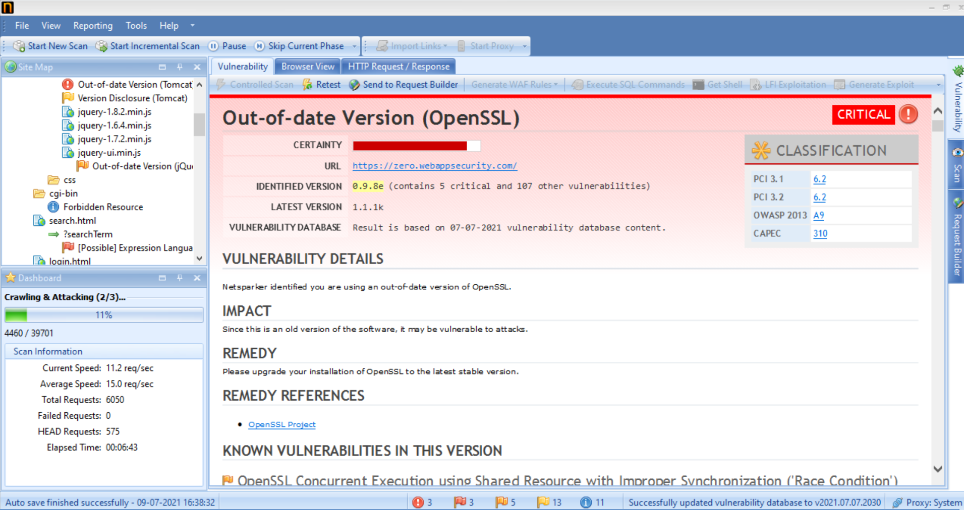

Slide 6
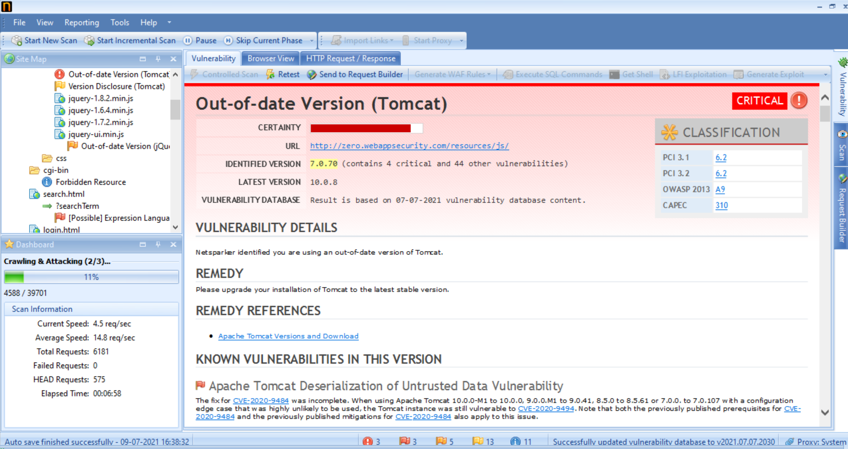

Slide 7
VULNERABILITY REPORT
Vulnerability Details : Netsparker identified you are using an Out-of-date version of Apache.
Severity : High
Instance :
URL - https://zero.webappsecurity.com/
Proof of Concept : Screen Shots of the Netsparker.
Impact : Since this is an old version of the software, it may be vulnerable to attacks.
: Allow remote attackers to obtain sensitive information via a crafted request that
triggers access to memory locations associated with an earlier request.
Remedy : Please upgrade your installation of Apache to the latest stable version.

Slide 8
THANK YOU
INTERNSHIPSTUDIO.COM

